Slide 1
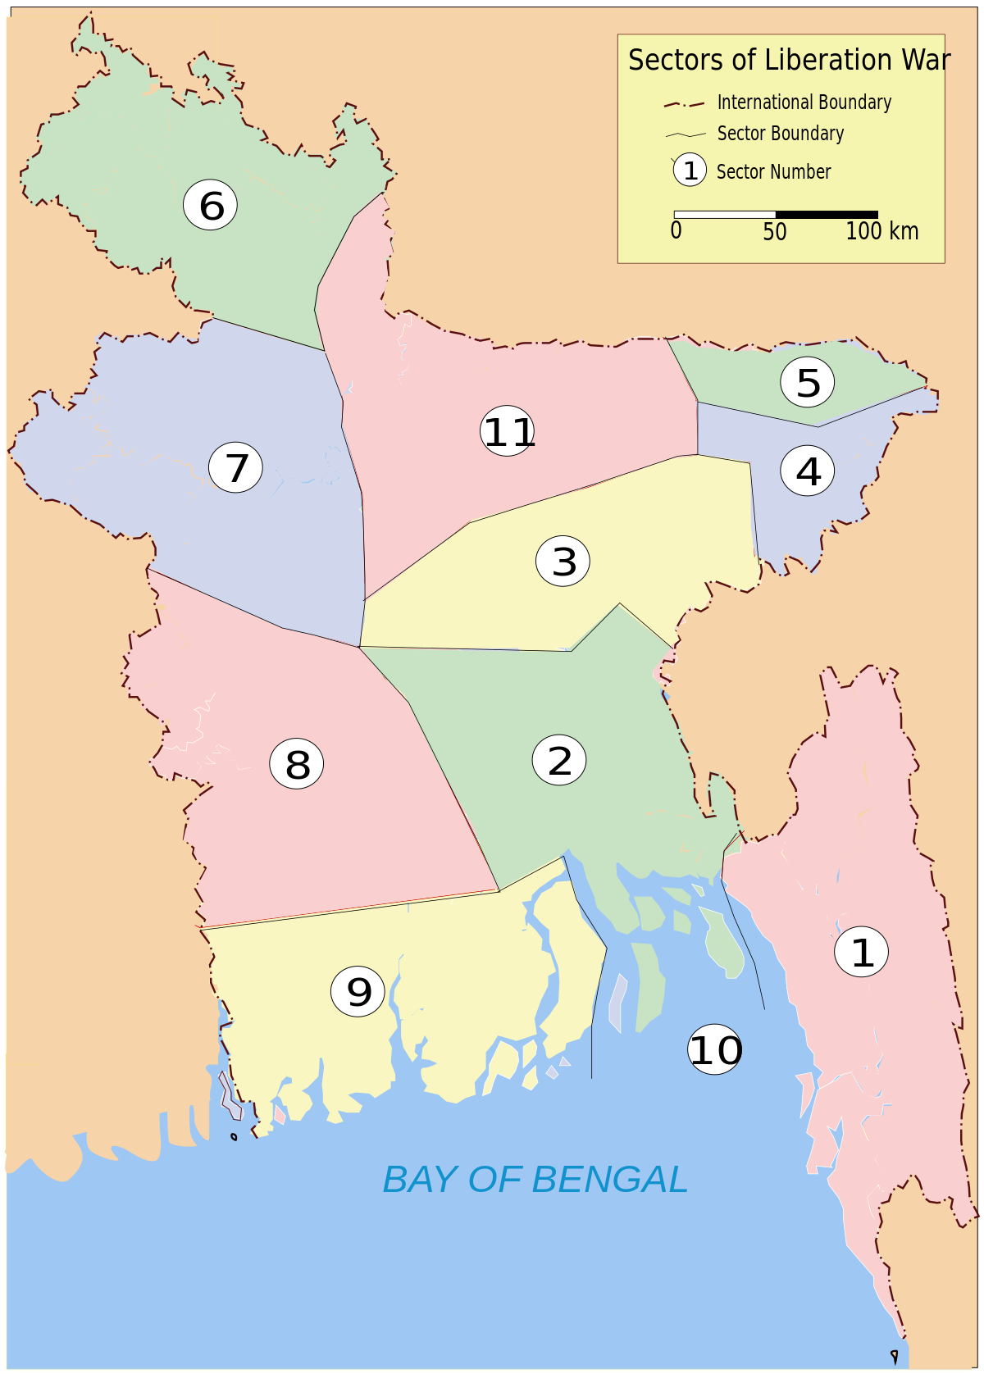
SECTORS IN 1971
Presented By Group-6,
Antique Roy Rupak - 2232262047
Joy Kumar Ghosh - 2211424642
Nowshin Faiza - 2233091630
Abid Ibnul Mahmood – 2231905630
Pallabi Talukder - 2312950627

Slide 2
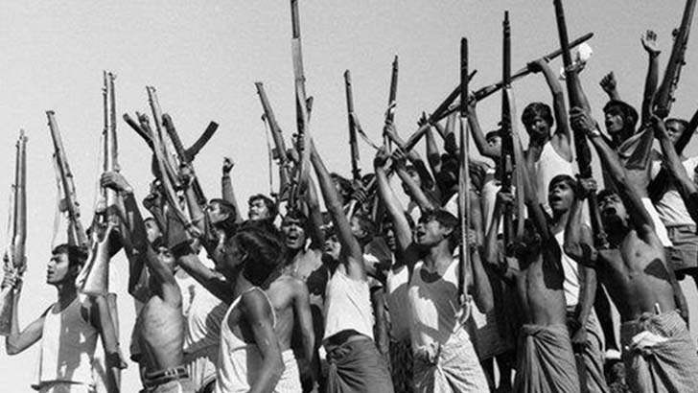

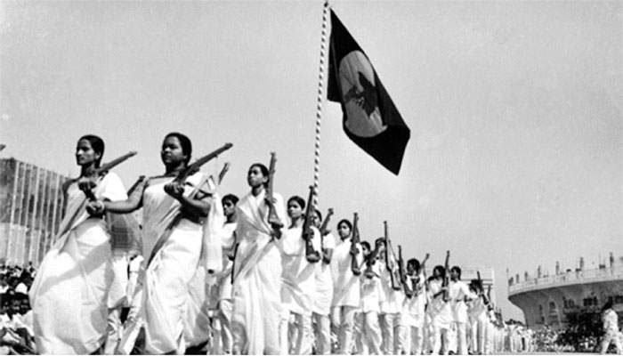
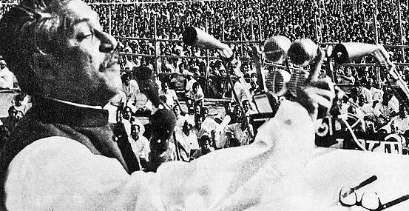

Slide 3
Arising Question
Who were the Sector Commanders, and what regions did they oversee during the Independence War in Bangladesh?
What were the key responsibilities and challenges faced by these Sector Commanders during the war?
How did the strategies and tactics employed by different Sector Commanders vary based on the regions they were responsible for?
What role did the Sector Commanders play in coordinating with the Mukti Bahini (freedom fighters) and foreign support in the war?
How did the leadership and dedication of these Sector Commanders contribute to the eventual victory and independence of Bangladesh?
What challenges did the Sector Commanders face in terms of logistics, communication, and resources during the war?
After the war, what roles did some of these Sector Commanders play in the newly independent Bangladesh?
How are the Sector Commanders of the Independence War remembered and honored in modern-day Bangladesh?

Slide 4
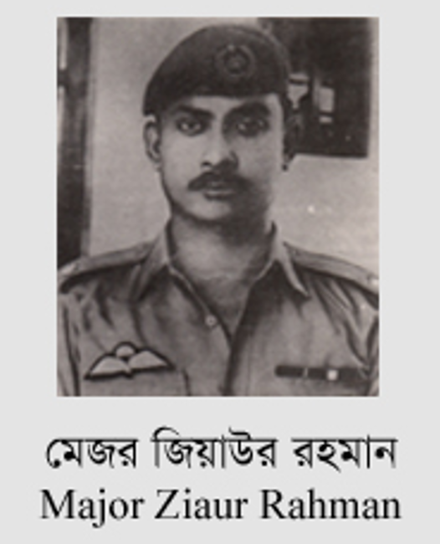
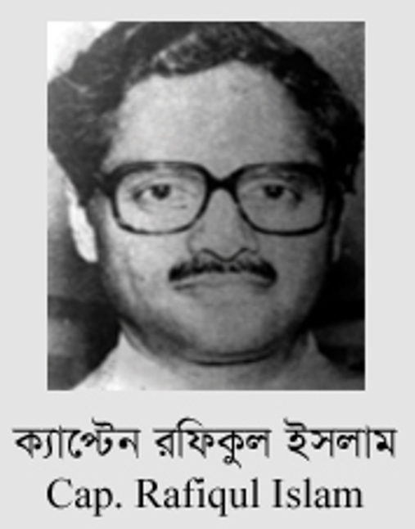
Sector 01: Chittagong and Chittagong Hill Tracts, Eastern Part of Noakhali
Headquarter: Harina
Commander: Major Rafiqul Islam
(June 10, 1971 – April 06, 1972)
Sector 01: Chittagong and Chittagong Hill Tracts, Eastern Part of Noakhali
Headquarter: Harina
Commander: Major Ziaur Rahman
(April 10, 1971 – May 05, 1971)
Contribution:
Announcement of Independence
Organized Infantry Unit
Provided Strong Leadership to Sector 1
Organized and Created Sector 11
Commander of Z Forces
Awarded “Bir Uttam” & “Icy Bravery”
1936-1981
1943 - Age 80

Slide 5
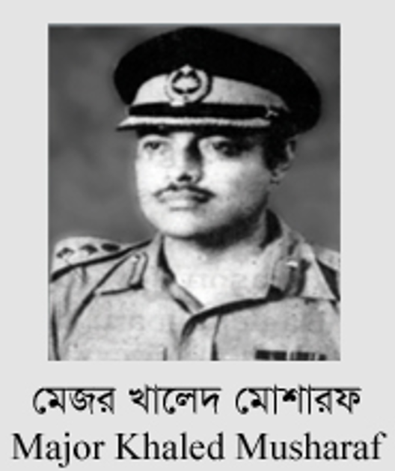
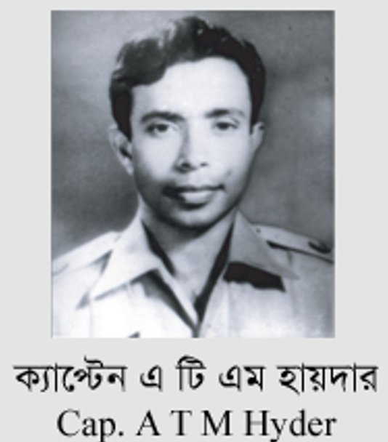
Sector 02: Dhaka, Comilla, Faridpur, and part of Noakhali
Headquarter: Melaghar
Commander: Major Khaled Mosharraf
(April 10, 1971 – September 22, 1971)
Sector 02: Dhaka, Comilla, Faridpur, and part of Noakhali
Headquarter: Melaghar
Commander: Major ATM Haider
(September 22, 1971 – April 06, 1972)
Contribution:
Second in Command of the 4th EBR
Provided Strong Leadership to Sector 2
Formed Crack Platoon
Wounded by Gunshot
Awarded “Bir Uttam”
Appointed Chief of General Staff of Bangladesh Army.
Contribution:
Went India and returned with Mukti Bahini Members
7 October 1971, Joined K Force, second-in-command
Command guerrilla attacks
Was promoted to Major and commanding officer of 13 EBR
Was promoted to Lieutenant Colonel in 1973
Awarded “Bir Uttam”
1937 - 1975
1942 - 1975

Slide 6
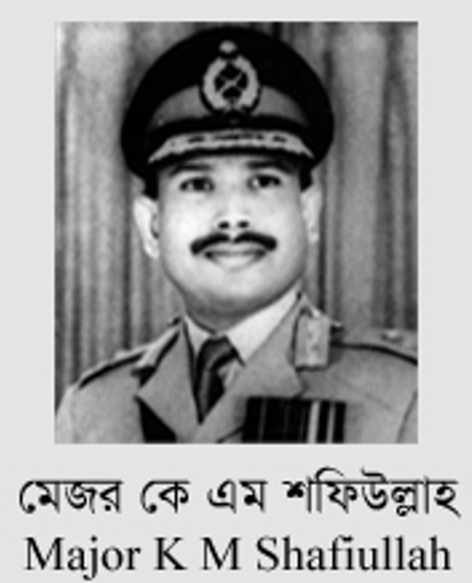
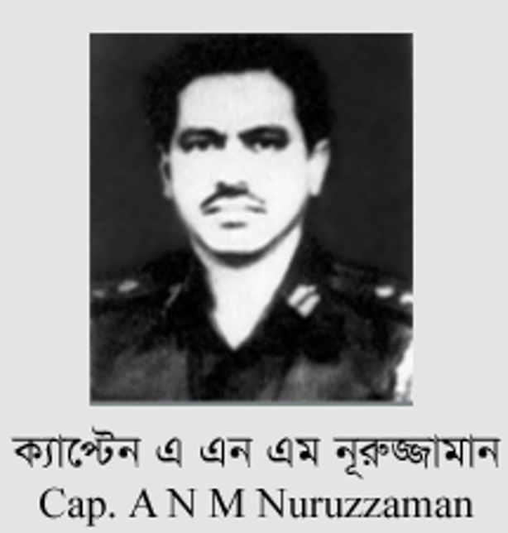
Sector 03: Churaman Kathi, north Sylhet, Singerbil of south Brahmanbaria
Headquarter: Hejamara
Commander: Major K. M. Shafiullah (April 10, 1971 – July 21, 1971)
Sector 03: Churaman Kathi, north Sylhet, Singerbil of south Brahmanbaria
Headquarter: Hejamara
Commander: A. N. M. Nuruzzaman
(July 23, 1971 – April 6, 1972)
Contribution:
Second in Command of the 2nd EBR
Revolted and killed 4 West Pakistani officers
Was appointed one of three brigade commanders, S-Force
Chief of Army Staff in April 1972
Awarded “Bir Uttam”
Contribution:
Joined S Force
Commander of sector-3
Promoted to brigadier general.
Awarded “Bir Uttam”
1938 - 1993
1934–Age 89

Slide 7
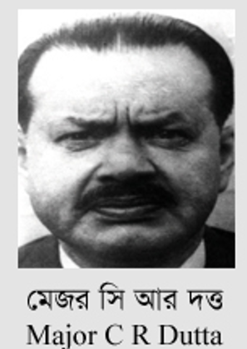
Sector 04: Habiganj District
Headquarter: Karimganj and later at Masimpur
Commander: Major Chitta Ranjan Dutta (April 10, 1971 – April 6, 1972)
Contribution:
Mentally prepared himself for a possible war
Key sector commander of the Mukti Bahini
Was appointed as brigade commander in Rangpur
Major-general of the Bangladesh Army
Awarded “Bir Uttam”
1929 – 2020

Slide 8
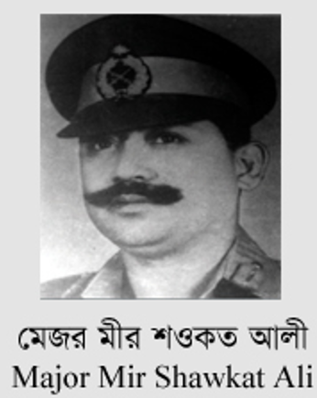
Sector 05: Durgapur to Dawki and eastern borders of Sylhet District
Headquarter: Banshtola
Commander: Major Mir Shawkat Ali (April 10, 1971 – April 6, 1972)
Contribution:
Joined the 8th EBR & revolted
Key sector commander of the Mukti Bahini
Commanded the Battle of Kalurghat in April 1971
Appointed & commanded 12 thousand men
Raid on Chhatak
Promoted to Lieutenant colonel.
Awarded “Bir Uttam”
1938 – 2010

Slide 9
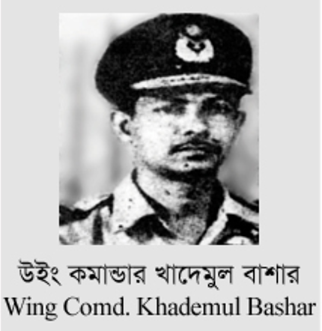
Sector 06: Rangpur District and part of Dinajpur District.
Headquarter: Burimari near Patgram
Commander:
Wing Commander M Khademul Bashar (April 10, 1971 – April 6, 1972)
Contribution:
Served as Senior Operations Officer of Tejgaon Air Base
Appointed as BDF Sector Commander
Formation of the Bangladesh Air Force in 1971
Awarded “Bir Uttam”
1935 – 1976

Slide 10
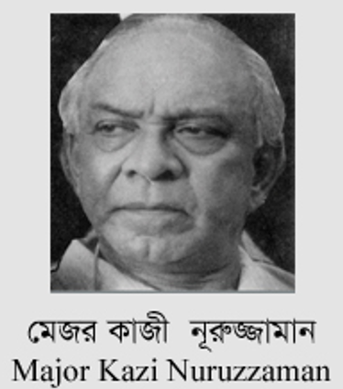
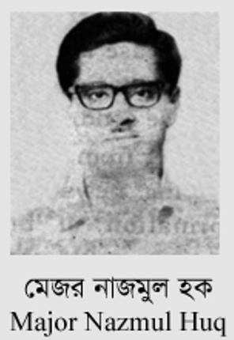
Sector 07: Rajshahi, Pabna, Bogra and part of Dinajpur District.
Headquarter: Tarangapur near Balurghat
Commander: Major Nazmul Huq
(April 10 – September 27, 1971)
Sector 07: Rajshahi, Pabna, Bogra and part of Dinajpur District
Headquarter: Tarangapur near Balurghat
Commander: Major Quazi Nooruzzaman (September 30 – April 6, 1972)
Contribution:
Directed the guerrilla warfare
Trained the independence militia
Commanded fifteen thousand freedom fighters including Bir Shrestho Captain Mohiuddin Jahangir
Died in a road accident on 27 September 1971
Contribution:
Principal commanders of the Mukti Bahini
Awarded “Bir Uttam” but rejected
1925 - 2011
1938 – 1971

Slide 11
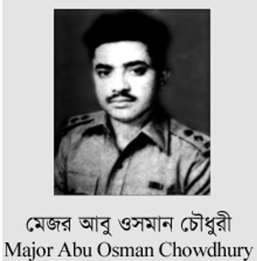
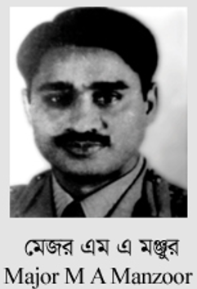
Sector 08: districts of Kushtia, Jessore, Khulna, Barisal, Faridpur and Patuakhali
Headquarter: Kalyani
Commander: Major Abul Manzoor
(August 14, 1971 – April 6, 1972)
Sector 08: districts of Kushtia, Jessore, Khulna, Barisal, Faridpur and Patuakhali
Headquarter: Kalyani
Commander: Major Abu Osman Chowdhury (April 10 – July 17, 1971)
Contribution:
Attacked 27 Baluch of Pakistan Army stationed
Take charge of the armed resistance force
Formed South Western Command
Hoisted the tri-color Bangladesh flag
Awarded the Independence Day Award
1936 – 2020
Contribution:
Escaped from West Pakistan
Commanded the Bangladesh Forces operations
Assassination of Ziaur Rahman
Awarded “Bir Uttam”
1940 - 1981

Slide 12
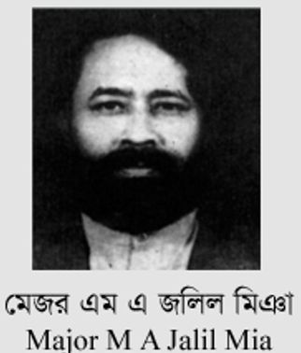
Sector 09: districts of Barisal and Patuakhali, and part of Khulna and Faridpur district
Headquarter: Taki near Bashirhat
Commander: Major M. A. Jalil
(July 17 – December 24, 1971)
1942 – 1989
Contribution:
Provided Strong Leadership to Sector 9
Founding members of political party Jatiyo Samajtantrik Dal

Slide 13
Sector 10: Constituted with the naval commandos
Commander: Eight Bangali officers of Pakistan Navy, Commands this sector, later commanded by MN Sumanta
Contribution:
They trained young student volunteers
Destruction and saboteering of coastal vessels
Destroyed seven ships including the Pakistani cargo ships MV Ohrmazd and MV Al-Abbas
In total of 17 Pakistani ships destroyed
Organized the navy for independent Bangladesh

Slide 14
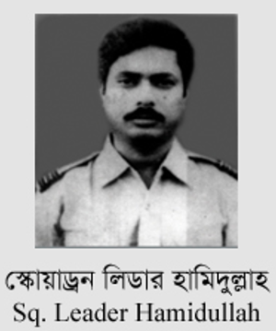
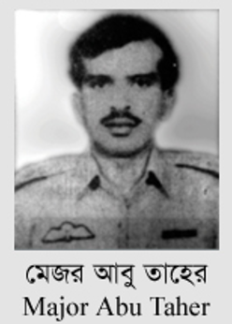
Sector 11: Mymensingh and Tangail, parts of Rangpur - Gaibandha, Ulipur, Kamalpur and Chilmari
Headquarter: Mahendraganj
Commander: Major Abu Taher
(October 10, 1971 – November 2, 1971)
Sector 11: Mymensingh and Tangail, parts of Rangpur - Gaibandha, Ulipur, Kamalpur and Chilmari
Headquarter: Mahendraganj
Commander: Sq. Leader M. Hamidullah Khan
(November 2, 1971 – April 6th, 1972)
Contribution:
Was sent to BDF HQ
Promoted to Major and appointed as subsector commander
October 10, handed over the commander of BDF sector 11
2 November 1971, lost his leg during debriefing
Awarded “Bir Uttam”
1938 – 1976
Contribution:
Planned and commanded the Chilmari river borne amphibious raid
Held three posts, officials of BD Govt., Principal BDF Representative of Guerilla Training, Commander of Sector 11
Promoted to Squadron Leader
Awarded “Bir Protik”
1938 - 2011

Slide 15
Food for thought
Imagine the challenges faced by the Sector Commanders and their brave soldiers in a war for independence. What qualities and values do you think were most crucial for their success, and how can we apply these lessons to our lives and society today?

Slide 16
Recap
The Sector Commanders were more than military leaders; they were symbols of determination, sacrifice, and resilience.
Their strategic brilliance and leadership, along with the spirit of the freedom fighters, led to Bangladesh's independence in 1971.
Their legacy reminds us of the enduring values of courage, unity, and patriotism.
This legacy continues to inspire us to advocate for justice, liberty, and the well-being of Bangladesh.
Their sacrifices underscore the preciousness of freedom, which we must cherish, protect, and pass on to future generations.

Slide 17
Call to Action
E
P
C
E
EDUCATE
PRESERVE
CONTRIBUTE
EMULATE

Slide 18
Thank You

